Slide 1
ABO Blood Types in MESA
Nicholas Larson, PhD
Assistant Professor of Biostatistics
Department of Health Sciences Research
Mayo Clinic College of Medicine

Slide 2
Outline
Background and Genetics of ABO
MESA ABO Genetic Data
Haplotype Estimation and ABO Allele Assignment
Distributional Characteristics of ABO in MESA
Associations with ABO and Cardiovascular Phenotypes
Conclusions and Future Work

Slide 3
(Brief) Biology of ABO
Red Blood Cell | Genotype
 | (O,O)
 | (A,O) (O,A) (A,A)
 | (B,O) (O,B) (B,B)
 | (A,B) (B,A)
The ABO system relates to the presence of A and/or B antigens on the surface of red blood cells (RBCs)
  ABO glycotransferases modify terminal ends of the H precursor antigen
ABO gene (ABO) is tri-allelic
  A, B, and O alleles
A and B alleles of ABO are genetically co-dominant
  Both antigens present on RBC for Type-AB
  O-allele lacks transferase ability
  Type-O necessarily homozygous for O-alleles
TYPE O
A
A
TYPE A
A
A
A
B
B
TYPE B
B
B
B
B
A
B
A
TYPE AB
A
B
B
A
B
A

Slide 4
ABO and Cardiovascular Disease (CVD)
There is a substantial publication history* of ABO blood type (and ABO SNPs) associated with CVD phenotypes
  Non-O with risk of venous thromboembolism (VTE), stroke
  Findings for myocardial infarction (MI) have been inconsistent
ABO is functionally related to von Willebrand factor (VWF), which is associated with thrombosis
  ABO glycotransferases directly modify VWF oligosaccharides in similar fashion to RBC H precursor antigens
  Non-O blood groups have higher plasma levels of VWF
Biological mechanism between ABO and CVD hypothesized to be combination of:
  Influence on VWF levels
  General ABO glycotransferase impact on cardio-metabolic pathways
*See: Zhang et al. (2012), IJVM 2012:641917.

Slide 5
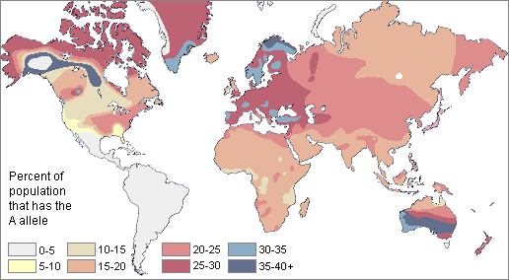
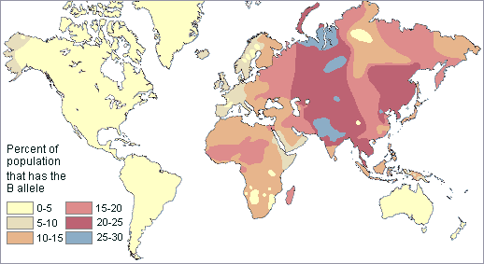
Differences in ABO Distributions
ABO allele frequencies (and thus blood types) differ greatly by population/geography
  Driving force behind these differences is not well understood
Distributional discrepancies in ABO Type across race may be relevant to racial differences in disease incidence
Image Source: A. E. Mourant et.al., The Distribution of the Human Blood Groups and Other Polymorphisms, 2nd ed. (1976)

Slide 6
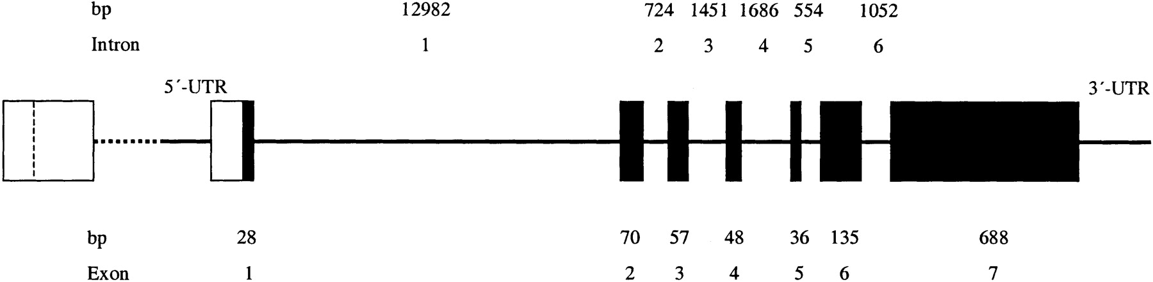
Genetics of ABO
Genetic sequence and structure of ABO determined in the mid-1990s
Relative to A101 as a genetic reference:
  A2-allele has frameshift mutation c.1061C>Del
  B-allele characterized by a number of key amino acid (AA) substitutions
  O-alleles: Transferase activity disabled in via either c.261G>Del (e.g., O01) OR 2 key AA substitutions (e.g., O03)
The NCBI Blood Group Antigen Gene Mutation Database (BGMUT) catalogs variation of blood group antigen genes, including ABO
  Currently lists 179 genetically unique ABO alleles
ABO (18 kb)
Image Source: Seltsam et al. (2003), Blood, 102(8)

Slide 7
Genetic ABO Profiling
ABO blood typing is traditionally conducted via serologic testing
However, direct interrogation of key functional variation and high linkage disequilibrium in ABO results in highly accurate ABO genetic profiling
  Successfully applied in multiple studies (e.g., Yip et al. 2000)
GOAL: Genetically determine ABO blood types in MESA
  Characterize ABO distributions by race
  Evaluate associations with cardiovascular phenotypes

Slide 8
MESA ABO Genetic Data
Previously merged genotype data from the three (3) Illumina chips (i.e., “chip data”)
  Exome BeadChip, Cardio-MetaboChip, and iSelect IBC Chip
  ~100 SNVs across ABO locus
  However, key functional variation required for ABO genetic profiling missing
Designed a custom Sequenom Panel including 10 ABO variants
  Run on 6316 MESA subjects
  Key deletions at c.261 and c.1059
Supplement Sequenom variants with chip data in analysis

Slide 9
Sequenom QC Summary
Variant-level QC by HWE, call rate (>90%)
  4 ABO variants failed (non-critical, 3 already in chip data)
Sample-level QC by panel call rate (≥75%): 61 failures
Three (3) SNPs (rs8176746, rs1053878, rs7853989) on Sequenom panel were also in the chip data
  Seven total samples had conflicting genotypes for at most 1 SNP
  Preference given to Sequenom genotype
Total of 28 ABO coding variants used for analysis
 | AFA | CHN | EUR | HIS | TOT
On Sequenom | 1638 | 760 | 2487 | 1431 | 6316
QC Passed | 1617 | 751 | 2471 | 1416 | 6255
w/ Chip Data | 1590 (98%) | 746 (99%) | 2446 (99%) | 1407 (99%) | 6189 (99%)

Slide 10
ABO Genotable for Major Alleles
Genetic Variants Used for MESA ABO Typing
 | Exon | 2 |  | 3 |  | 4 |  |  | 5 | 6 |  |  | 7
 | CDS Position | 46 | 53 | 103 | 106 | 188 | 189 | 190 | 220 | 261 | 297 | 318 | 467 | 488 | 526 | 542 | 579 | 595 | 646 | 657 | 681 | 703 | 729 | 768 | 771 | 796 | 803 | 930 | 1061
 | In Sequenom
Common ABO Alleles | A101 (ref.) | G | G | G | G | G | C | G | C | G | A | C | C | C | C | G | T | C | T | C | G | G | C | C | C | C | G | G | C
 | A102 |  |  |  |  |  |  |  |  |  |  |  | T
 | A201 |  |  |  |  |  |  |  |  |  |  |  | T |  |  |  |  |  |  |  |  |  |  |  |  |  |  |  | -
 | B101 |  |  |  |  |  |  |  |  |  | G |  |  |  | G |  |  |  |  | T |  | A |  |  |  | A | C | A
 | O01 |  |  |  |  |  |  |  |  | -
 | O02 |  |  |  | T | A | T |  | T | - | G |  |  |  |  |  |  |  | A |  | A |  |  |  | T
 | O03 |  | T |  |  |  |  |  |  |  | G |  | T |  | G
= In both data sources
-
= Deletion

Slide 11
Haplotype Estimation Methods
Un-phased genotypes represent “incomplete information”
  Do not directly observe phased haplotypes (i.e., alleles)
To translate ABO genotype vectors into estimated haplotypes, we applied an expectation-maximization (EM) algorithm from the R statistical package haplo.stats
  De novo allele frequency estimation via statistical phasing
  Can accommodate missing genetic data
  Analyses stratified by race (i.e., race-specific hap’s and freq’s)
Additionally provides posterior probabilities (PPr) of haplotype pairs (i.e., diplotypes) per subject
Assigned MESA diplotypes based on PPr > 0.90

Slide 12
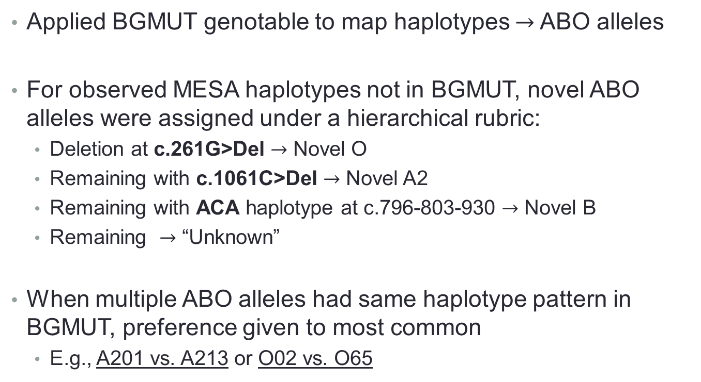
Assigning Haplotypes to ABO Alleles
Applied BGMUT genotable to map haplotypes $→$ ABO alleles
For observed MESA haplotypes not in BGMUT, novel ABO alleles were assigned under a hierarchical rubric:
  Deletion at c.261G>Del $→$ Novel O
  Remaining with c.1061C>Del $→$ Novel A2
  Remaining with ACA haplotype at c.796-803-930 $→$ Novel B
  Remaining $→$ “Unknown”
When multiple ABO alleles had same haplotype pattern in BGMUT, preference given to most common
  E.g., A201 vs. A213 or O02 vs. O65

Slide 13
MESA ABO Allele Frequencies
Allele frequencies differ greatly by race
  EUR and HIS were closest in frequencies
Sum of type-unknown frequencies in AFA ~ 1%
  High percentage of novel O alleles (15.4%)
Surprisingly little allelic variation among CHN
  No A2 alleles
  Chip designs may be a factor
Allele |  | Frequency Estimates
 |  | AFA | CHN | EUR | HIS
A | A101 | 0.08 | 0.03 | 0.20 | 0.13
 | A102 | 0.04 | 0.17 | <0.01 | 0.01
 | A201 | 0.06 | 0.00 | 0.07 | 0.04
 | A (other) | <0.01 | <0.01 | <0.01 | <0.01
B | B101 | 0.12 | 0.19 | 0.08 | 0.06
 | B (other) | <0.01 | <0.01 | <0.01 | <0.01
O | O01 | 0.24 | 0.34 | 0.35 | 0.30
 | O02 | 0.09 | 0.27 | 0.16 | 0.26
 | O09 | 0.12 | 0.00 | <0.01 | 0.02
 | O (other) | 0.26 | <0.01 | 0.14 | 0.18
? | Unknown | 0.01 | <0.01 | <0.01 | <0.01

Slide 14
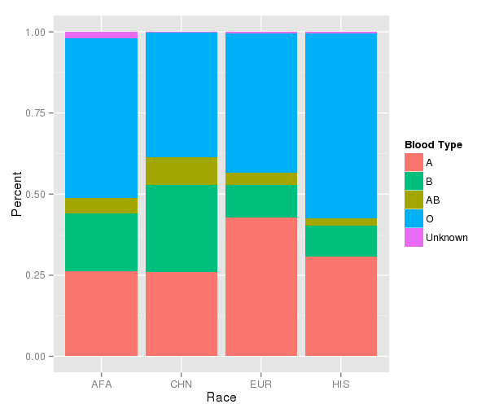
MESA ABO Type Distribution Summary
ABO rates highly concordant with previously reported frequencies in similar populations
Higher frequencies of Type-B in AFA (18.2%) and CHN (26.4%)
HIS has highest Type-O rate (57.2%)
 | ABO Typing Summary – N (% of Total)
 | AFA | CHN | EUR | HIS
Total | 1617 (1.00) | 751 (1.00) | 2471 (1.00) | 1416 (1.00)
With Haps (PPr > 0.90) | 1536 (0.95) | 743 (0.99) | 2437 (0.99) | 1396 (0.99)
With ABO Type | 1517 (0.94) | 743 (0.99) | 2424 (0.98) | 1393 (0.98)

Slide 15
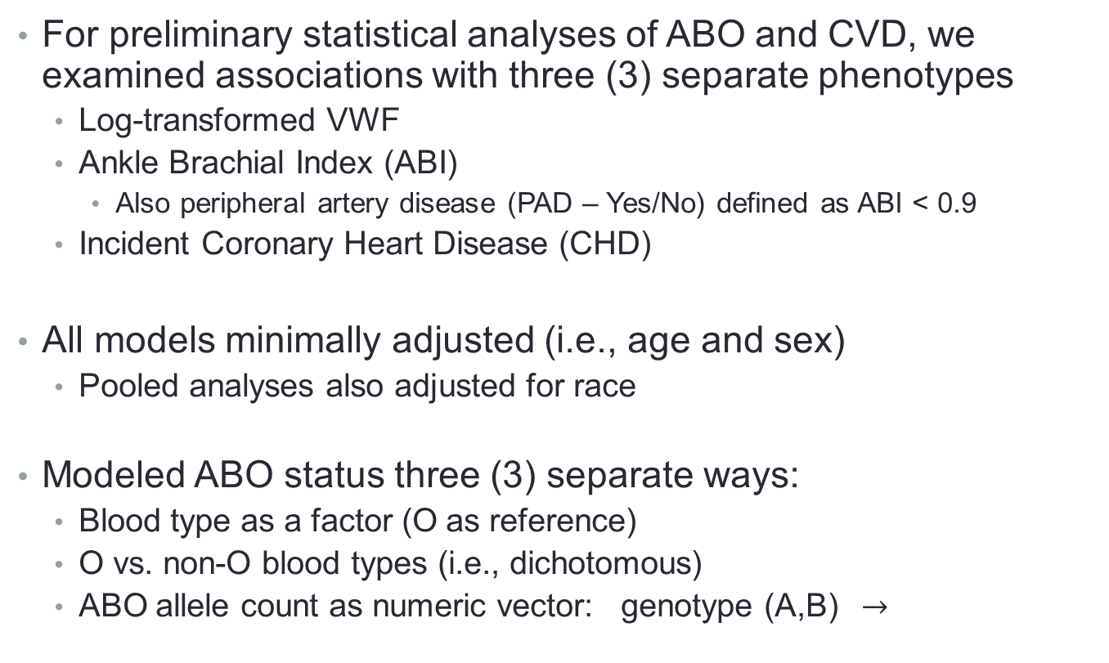
ABO Associations with CVD in MESA
For preliminary statistical analyses of ABO and CVD, we examined associations with three (3) separate phenotypes
  Log-transformed VWF
  Ankle Brachial Index (ABI)
    Also peripheral artery disease (PAD – Yes/No) defined as ABI < 0.9
  Incident Coronary Heart Disease (CHD)
All models minimally adjusted (i.e., age and sex)
  Pooled analyses also adjusted for race
Modeled ABO status three (3) separate ways:
  Blood type as a factor (O as reference)
  O vs. non-O blood types (i.e., dichotomous)
  ABO allele count as numeric vector: genotype (A,B) $→$
A | B | O
1 | 1 | 0

Slide 16
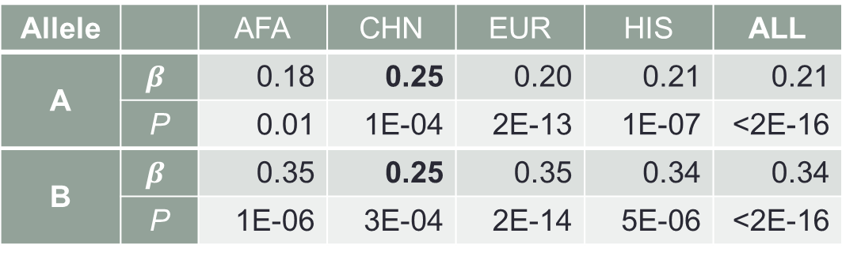
Results: ABO and VWF
Log(VWF) was modeled using linear regression
  “Sanity Check”
As expected, associations with ABO highly significant across all races
  Higher VWF for non-O Types
Allele count analysis reveals A- and B-alleles may have different effects (except CHN?)
Allele |  | AFA | CHN | EUR | HIS | ALL
A | $$β$$ | 0.18 | 0.25 | 0.20 | 0.21 | 0.21
 | P | 0.01 | 1E-04 | 2E-13 | 1E-07 | <2E-16
B | $$β$$ | 0.35 | 0.25 | 0.35 | 0.34 | 0.34
 | P | 1E-06 | 3E-04 | 2E-14 | 5E-06 | <2E-16

Slide 17
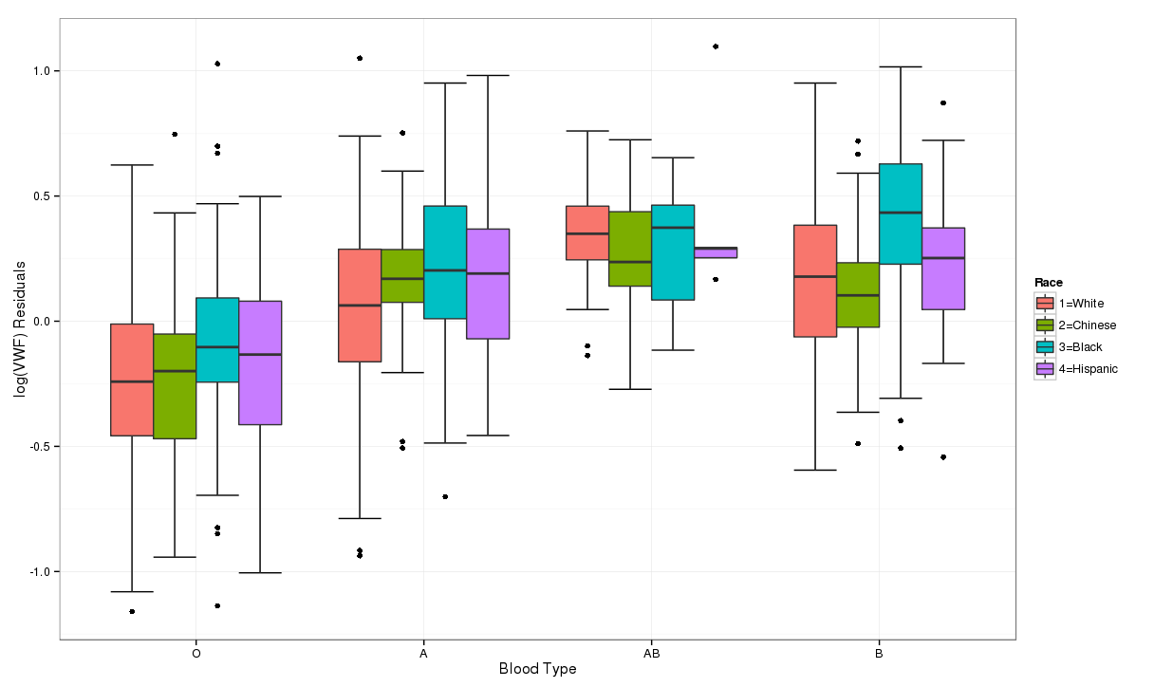
Distribution of VWF by ABO Type

Slide 18
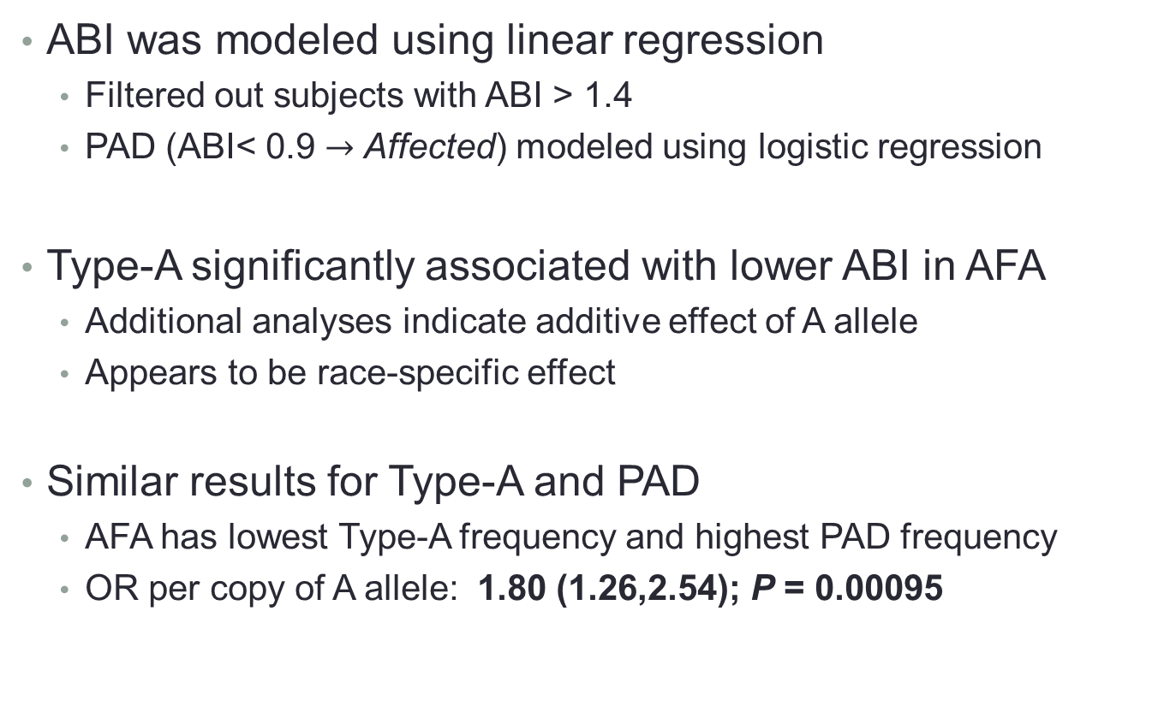
Results: ABO and ABI/PAD
ABI was modeled using linear regression
  Filtered out subjects with ABI > 1.4
  PAD (ABI< 0.9 $→$ Affected) modeled using logistic regression
Type-A significantly associated with lower ABI in AFA
  Additional analyses indicate additive effect of A allele
  Appears to be race-specific effect
Similar results for Type-A and PAD
  AFA has lowest Type-A frequency and highest PAD frequency
  OR per copy of A allele: 1.80 (1.26,2.54); P = 0.00095

Slide 19
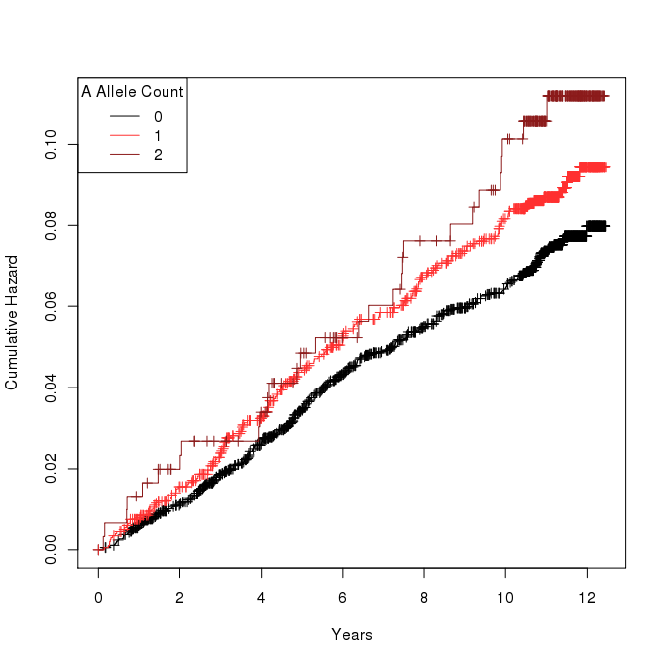
Results: ABO and CHD
All Mesa Subjects
No significant associations with CHD and ABO Type
  Either as factor or O vs. non-O
  Similar results when stratifying by gender
  Limited by lack of events
Risk association with A-allele count in pooled analysis
  HR = 1.20 (1.02,1.40)
  P = 0.025

Slide 20
Conclusions and Future Work
Successfully assigned ABO blood types to 94-99% of MESA cohort
  Identified large number of novel alleles (especially in AFA)
  Genetic diversity in AFA made haplotyping relatively more difficult
  More generic modeling of ABO could increase typing rate (178 w/o ABO)
ABO association results for ABI and CHD indicate potential role of A-allele count
  Increased risk of CHD with A-allele carriers?
  Lower ABI, increased PAD risk in AFA with Type-A
Multiple ways to model ABO blood type at finer granularity
  E.g., A1 vs. A2 alleles (role in CHN?)
Effect modifications? Correlation with other risk factors?
Manual curation of remaining haplotypes to determine ABO status
  38 total subjects with PPr > 0.9 but unknown ABO status
  Likely A1 alleles

Slide 21




Acknowledgments
MESA Adhesion Study
  Suzette J. Bielinski, PhD
  Mariza de Andrade, PhD
  Paul A. Decker, MS
  Phil Kirsch, MPH
  Hughes Sicotte, PhD
  Nicholas B. Larson, PhD
  Cecilia Berardi, MD
  Michael Tsai, MD
  Naomi Hanson, MS
  James S. Pankow, PhD
  Weihong Tang, PhD
  Michele Sale, PhD
  Christina Wassel, PhD
CardioMetaboChip Collaborators
  MESA Air
    Joel D. Kaufman
    Sverre Vedal
  MESA Genotype
    Jerome I. Rotter
    Kent D. Taylor
    Yii-Der Ida Chen
    Xiuqing Guo
  MESA CC
    Kayleen Williams

Slide 22
ADDITIONAL SLIDES

Slide 23

Haplotype Estimation Methods – “EM”
“MAXIMIZATION”
Estimate
haplotype allele frequencies
Subject $i$
Geno
H1
H2
Frequency
1
2
1
1
0
1
1
0
0
0
0
1
1
1
0
Iterate until convergence
H1
H2
H3
H4
Determine most likely haplotypes from genotypes
“EXPECTATION”

Slide 24
Number of Estimated Haplotypes
AFA had highest number of estimated haplotypes
  CHN lowest
Although AFA had 17 unknown haplotypes (no ABO assignment), corresponding frequencies VERY low (<0.001)
 | Number of Estimated Haplotypes
 | AFA | CHN | EUR | HIS
In BGMUT | 20 | 7 | 17 | 21
Novel A/B/O | 40 | 4 | 22 | 27
Unknown | 17 | 1 | 6 | 4
Total | 77 | 12 | 45 | 52

Slide 25
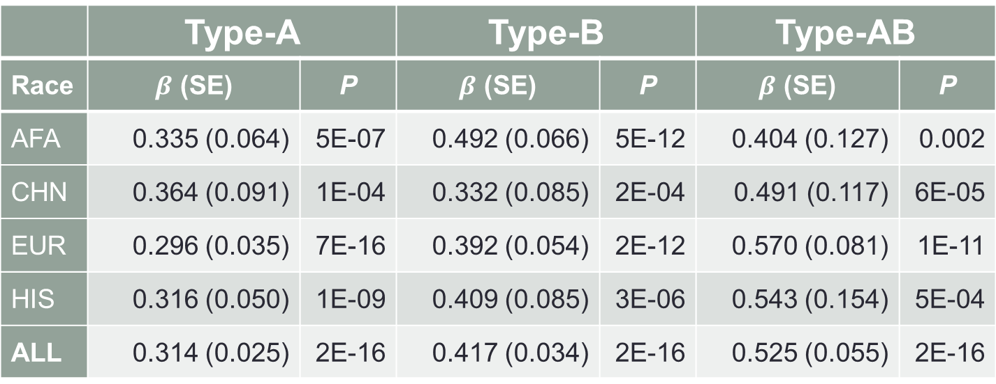
Analysis Results – VWF (by Type)
 | Type-A |  | Type-B |  | Type-AB
Race | $β$ (SE) | P | $β$ (SE) | P | $β$ (SE) | P
AFA | 0.335 (0.064) | 5E-07 | 0.492 (0.066) | 5E-12 | 0.404 (0.127) | 0.002
CHN | 0.364 (0.091) | 1E-04 | 0.332 (0.085) | 2E-04 | 0.491 (0.117) | 6E-05
EUR | 0.296 (0.035) | 7E-16 | 0.392 (0.054) | 2E-12 | 0.570 (0.081) | 1E-11
HIS | 0.316 (0.050) | 1E-09 | 0.409 (0.085) | 3E-06 | 0.543 (0.154) | 5E-04
ALL | 0.314 (0.025) | 2E-16 | 0.417 (0.034) | 2E-16 | 0.525 (0.055) | 2E-16
(ALL SIGNIFICANT)

Slide 26
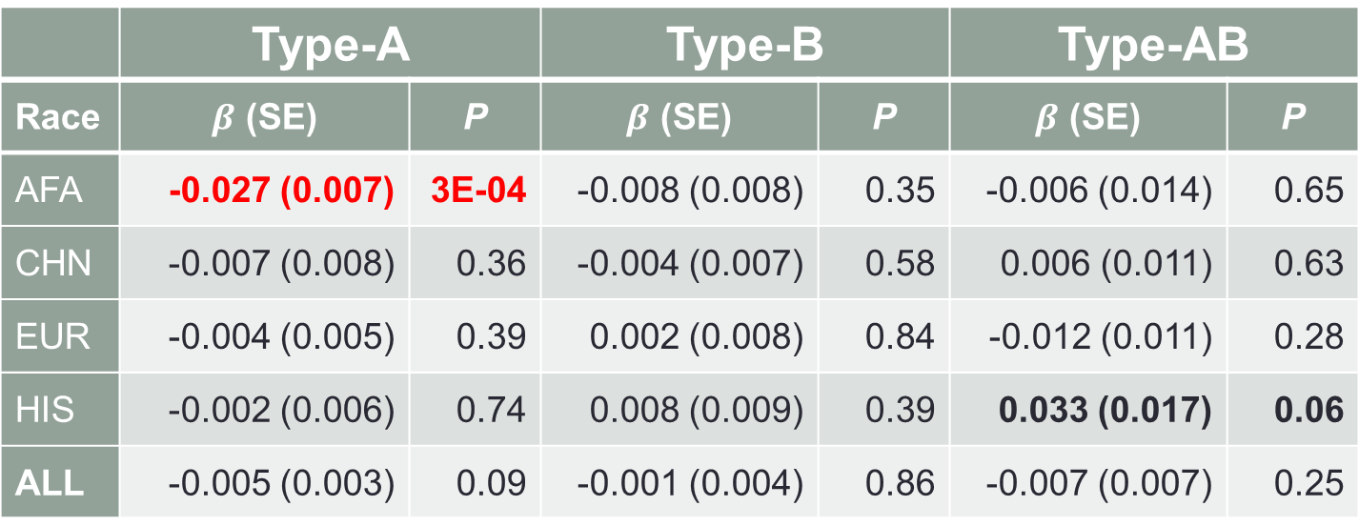
Analysis Results – ABI (by Type)
 | Type-A |  | Type-B |  | Type-AB
Race | $β$ (SE) | P | $β$ (SE) | P | $β$ (SE) | P
AFA | -0.027 (0.007) | 3E-04 | -0.008 (0.008) | 0.35 | -0.006 (0.014) | 0.65
CHN | -0.007 (0.008) | 0.36 | -0.004 (0.007) | 0.58 | 0.006 (0.011) | 0.63
EUR | -0.004 (0.005) | 0.39 | 0.002 (0.008) | 0.84 | -0.012 (0.011) | 0.28
HIS | -0.002 (0.006) | 0.74 | 0.008 (0.009) | 0.39 | 0.033 (0.017) | 0.06
ALL | -0.005 (0.003) | 0.09 | -0.001 (0.004) | 0.86 | -0.007 (0.007) | 0.25

Slide 27
Analysis Results – PAD (by Type)
 | Type-A |  | Type-B |  | Type-AB
Race | OR (95% CI) | P | OR (95% CI) | P | OR (95% CI) | P
AFA | 2.06 (1.29,3.30) | 3E-03 | 0.66 (0.30,1.30) | 0.25 | 1.47 (0.48,3.67) | 0.45
CHN | 5.64 (1.31,38.8) | 0.035 | 3.01 (0.57,22.2) | 0.21 | 2.11 (0.10,23.1) | 0.55
EUR | 0.78 (0.47,1.28) | 0.33 | 0.71 (0.26,1.59) | 0.44 | 1.46 (0.49,3.54) | 0.45
HIS | 0.54 (0.18,1.35) | 0.22 | 0 (NA,NA) | 0.99 | 1.24 (0.65,7.08) | 0.84
ALL | 1.22 (0.90,1.66) | 0.20 | 0.62 (0.37,1.00) | 0.06 | 1.37 (0.69,2.48) | 0.33

Slide 28
Analysis Results – CHD (By Type)
 | Type-A |  | Type-B |  | Type-AB
Race | HR (95% CI) | P | HR (95% CI) | P | HR (95% CI) | P
AFA | 1.53 (0.96,2.47) | 0.07 | 1.04 (0.57,1.87) | 0.44 | 1.40 (0.59,3.26) | 0.44
CHN | 1.69 (0.80,3.56) | 0.17 | 1.55 (0.71,3.39) | 0.28 | 0.78 (0.17,3.46) | 0.74
EUR | 1.02 (0.76,1.37) | 0.88 | 0.69 (0.40,1.19) | 0.18 | 1.13 (0.57,2.25) | 0.72
HIS | 1.28 (0.83,1.95) | 0.26 | 0.50 (0.20,1.26) | 0.14 | 1.57 (0.49,5.02) | 0.45
ALL | 1.21 (0.98,1.49) | 0.07 | 0.84 (0.61,1.16) | 0.29 | 1.17 (0.73,1.85) | 0.51

Slide 29
Analysis Results – CHD (by Count)
 | A-Allele |  | B-Allele
Race | HR (95% CI) | P | HR (95% CI) | P
AFA | 1.30 (0.91,1.84) | 0.14 | 1.02 (0.66,1.57) | 0.94
CHN | 1.17 (0.70,1.95) | 0.56 | 1.08 (0.60,1.93) | 0.80
EUR | 1.15 (0.93,1.43) | 0.19 | 0.91 (0.62,1.35) | 0.65
HIS | 1.24 (0.87,1.77) | 0.24 | 0.64 (0.32,1.29) | 0.21
ALL | 1.20 (1.02,1.40) | 0.025 | 0.92 (0.72,1.17) | 0.50

